Slide 1

Bike Sharing Demand Prediction.
Regression Capstone project
BY
Saurabh Vijaykumar Gaikwad

Slide 2
Project Summary:-
Project activities have been categorised as under:
Defining the problem statement i.e. Business Objective of the study. Collection and preparation of data by data cleaning , treating outliers etc. Perform exploratory data analysis through a deep study of relationship between different features, generate new variables based on need inline with related business objectives. Present the data in easily understandable form. Provide observations as well as recommendations based on model.prepare the model train it and with the help of various algorithm.Build our model to be capable of predict right predictions based on it's training.

Slide 3
Problem Statement:-
The dataset contains weather information (Temperature, Humidity, Windspeed, Visibility, Dewpoint, Solar radiation, Snowfall, Rainfall), the number of bikes rented per hour and date information Now a Days Rental bikes are introduced in many urban cities for the enhancement of mobility comfort. It is important to make the rental bike available and accessible to the public at the right time as it lessens the waiting time. Eventually, providing the city with a stable supply of rental bikes becomes a major concern. The crucial part is the prediction of bike count required at each hour for the stable supply of rental bikes.

Slide 4
VARIABLES DESCRIPTION:-
Date= Display date
Hour= Hour of the day (0-23)
Temperature= Temperature of the Day
Humidity= Humidity measure
Wind speed= Wind speed
Visibility= Visibility
Dew Point Temperature= Dew point Temperature Measure
Solar Radiation= Solar Radiation Measure
Rainfall= Rainfall in mm
Snowfall= Snowfall Measure
Seasons= Seasons like spring,summer,fall,winter
Holiday= Whether the holiday or not
Functional Day= Whether a function day or not

Slide 5
Python Libraries used:-
Numpy
Pandas
Matplotlib
Seaborn
sklearn

Slide 6
Data Wrangling:-
First thing we did was, make a copy of original dataset to work on.
Then I removed no functional day rows and after that I totally removed full functional day column.
I also splitted Day,Month,Year from Date column.
After that I separated Numerical type and categorical type data and placed it in different variables.

Slide 7
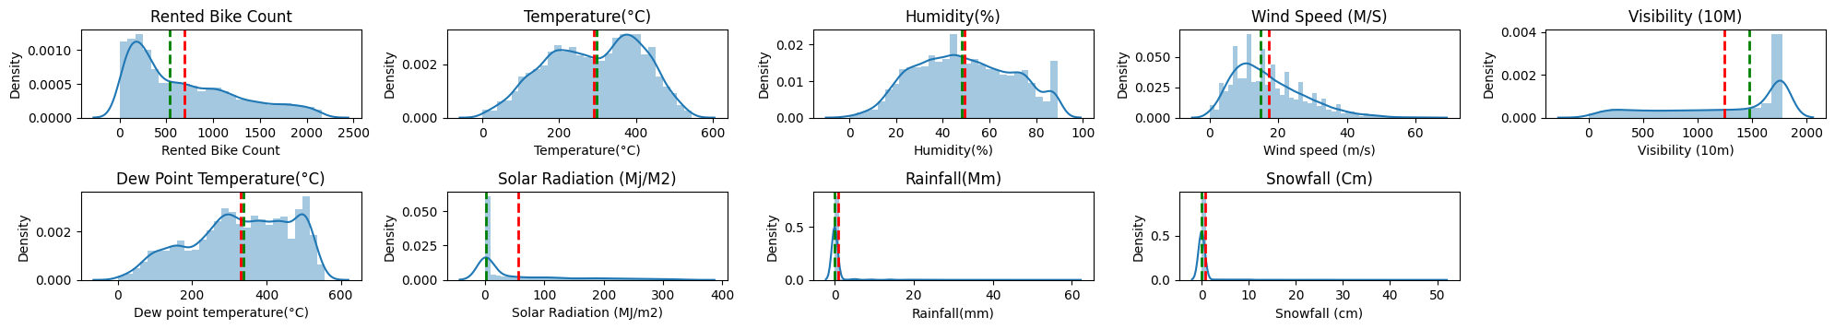
Data Visualization:-
Distplot to display the density of variable:-
This graph is found using Distplot.Here i calculated the density of each independent and dependent variable.From this graph you can easily see the skewness of our data.

Slide 8

pairplot:-
As we can see in the image this is a Pair plot which gives us the Relationship of Each and every data point of variable with respect to other variable.

Slide 9
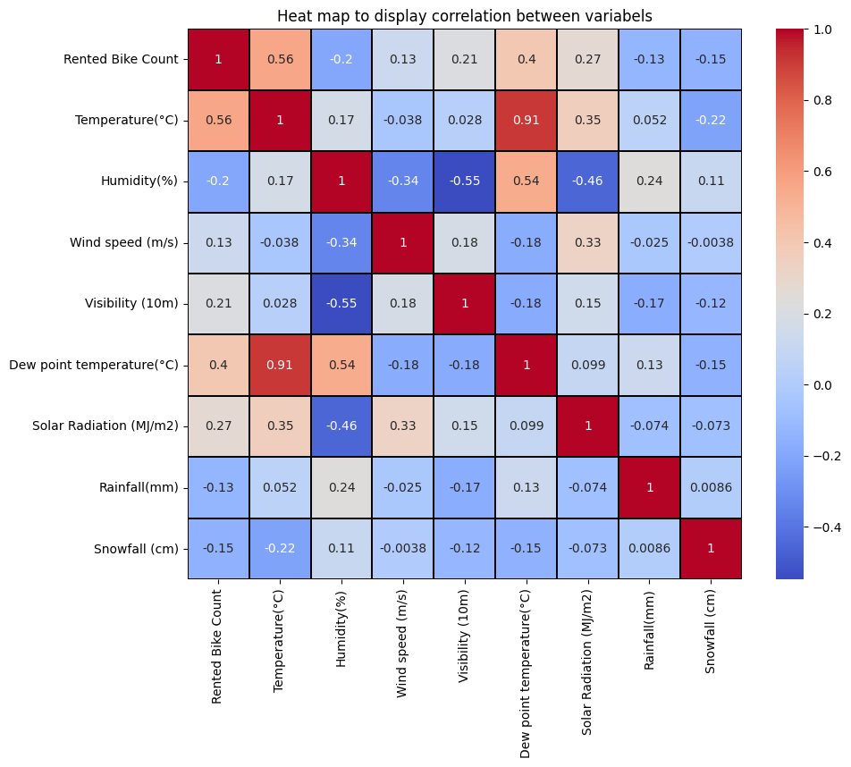
Heatmap:-
This is a Heatmap Which used to show the Relationships of variable with other variable.Here as we can see the correlation between Dew Point Temperature with Temperature is very high it display itself in red color so we have to remove one of the column to avoid multicollinearity

Slide 10
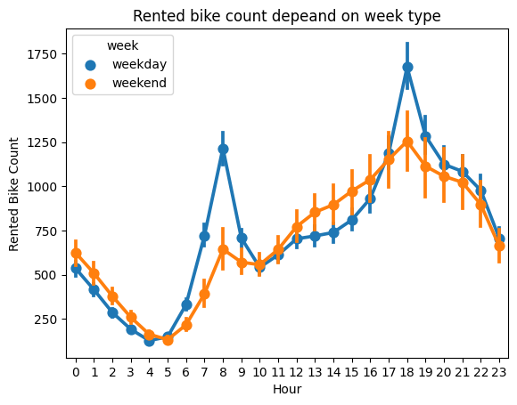
Weekly Rented Bike Count:-
This is a Point plot from seaborn Library. As you can see the weekday line is above the weekend pointplot line we can say that during weekday Rented bike count is more as compared to weekend Rented bike count.

Slide 11
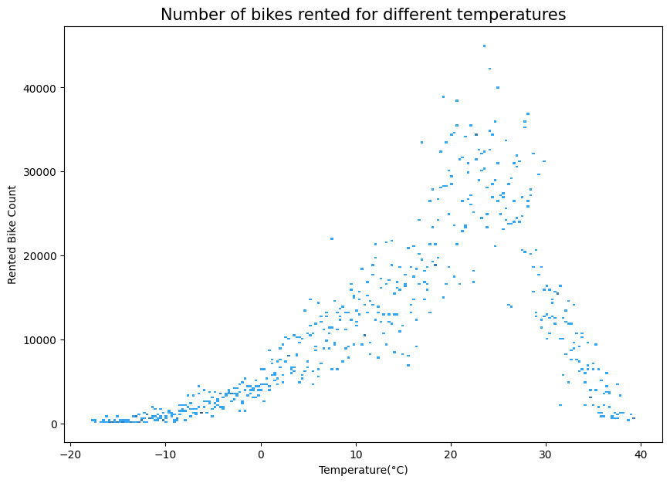
Temperature effect on Rented Bike Count:-
In the given graph on X axis the Temperature and on Y axis the Rented Bike Count is Given.
As the Data points are peak in between the 20 to 30 we can conclude that the Rented bike count is high in between 20 to 30 degree.

Slide 12
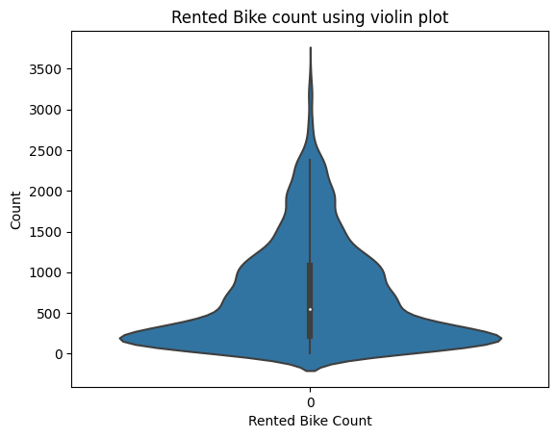
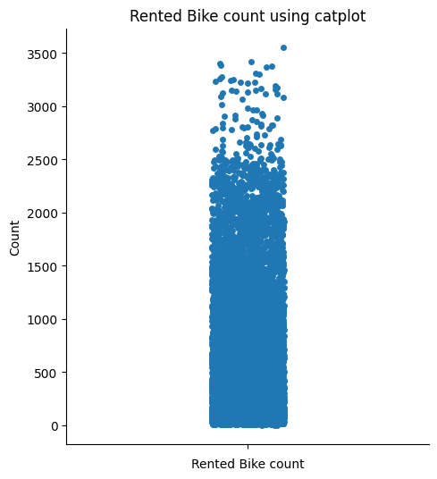
Rented Bike Count:-
Here In both figure displayed above the first one is violin and second is catplot These two plots display us how is the data is distributed across the entire dataset.we can easily see as data points are wide in 0 to 500.And as we go above the data distribution is less.

Slide 13
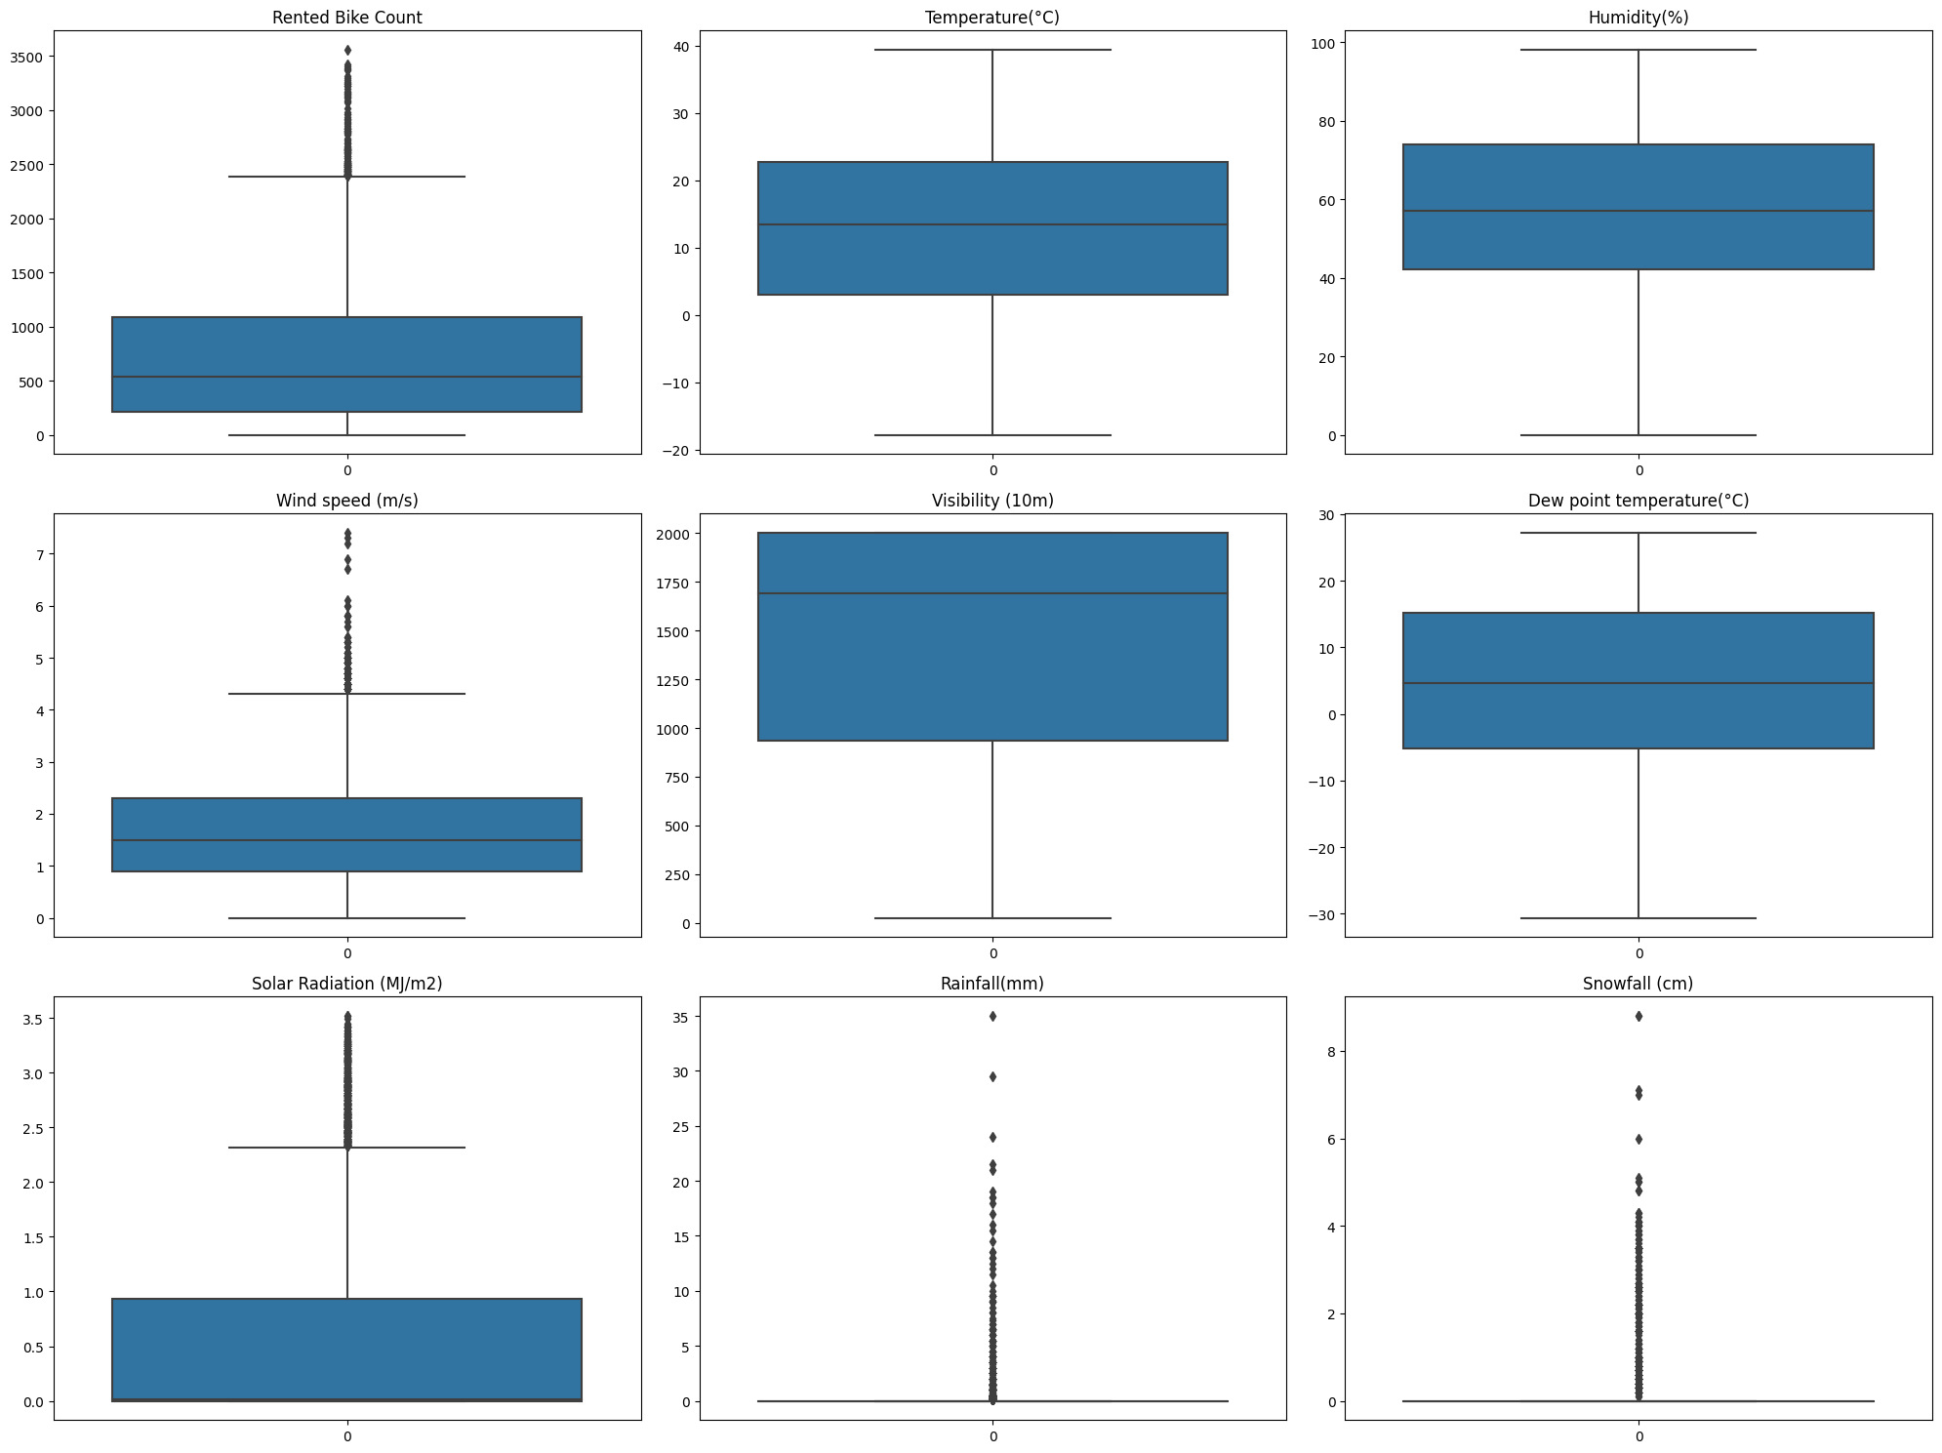
Boxplot:-
Boxplot is one of the most important
Plot.Because it helps to display the outliers in our dataset and we can treat these outliers to get clean and good quality model.

Slide 14
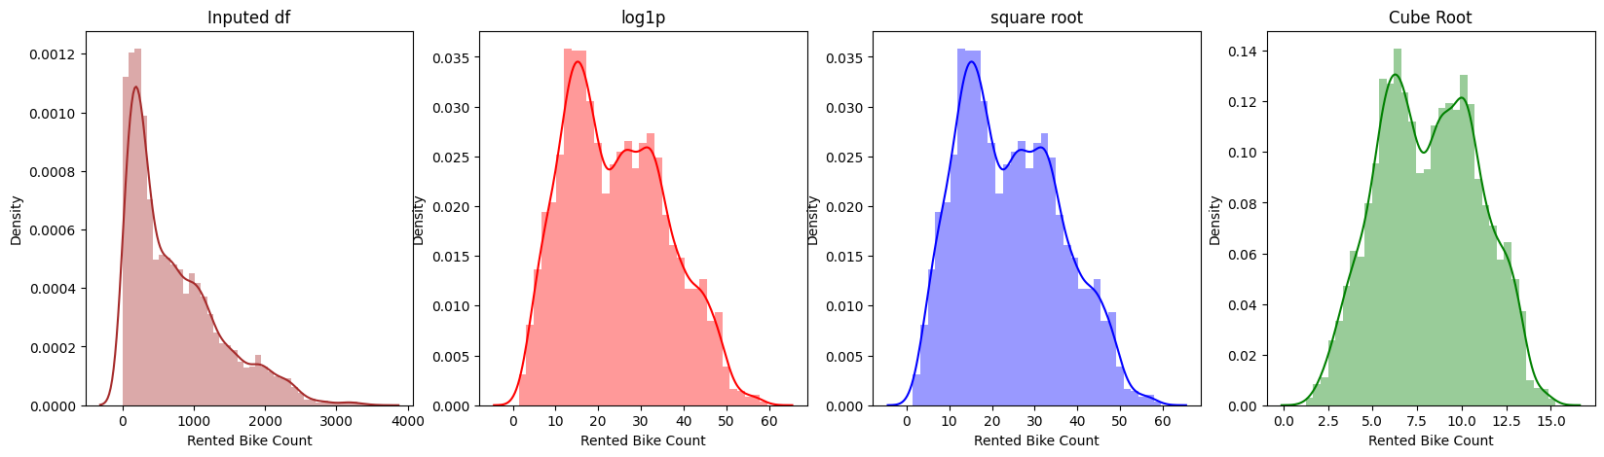
Transformation on dependent variable:-
Here we used three transformation techniques i.e log,square root, cube root.among the three the cube root technique is best technique as we can observe from figure.

Slide 15
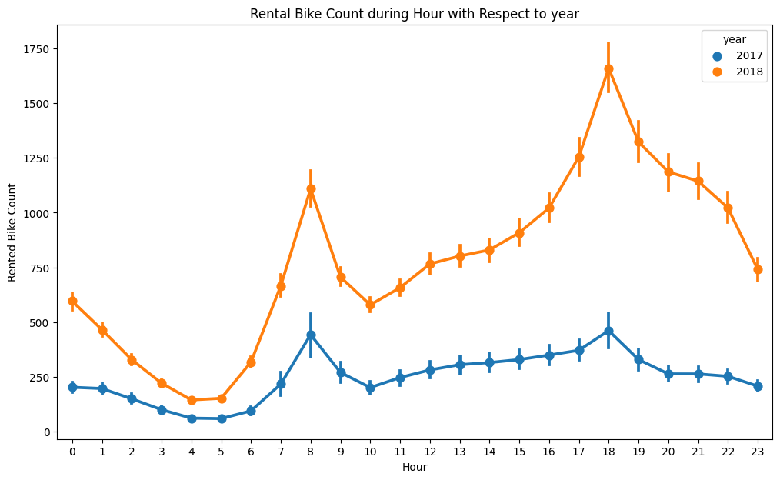
Rented bike count in different year:-
In the given figure the Rented bike count per hour displayed with respect to year.so as we can see the 2018 has more number of hourly bike count
As compared to 2017.

Slide 16
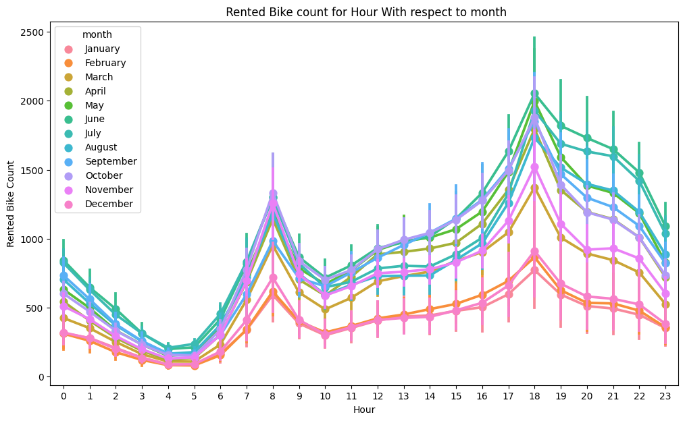
Hourly Rented bike count in different months:-
This is point plot and on the X-axis the Hour and Y-axis the Rented Bike Count is Displayed.as graph is showing the hourly count of rented bike in different month and most of rented bike count months are may,june,august and less is november and december.

Slide 17
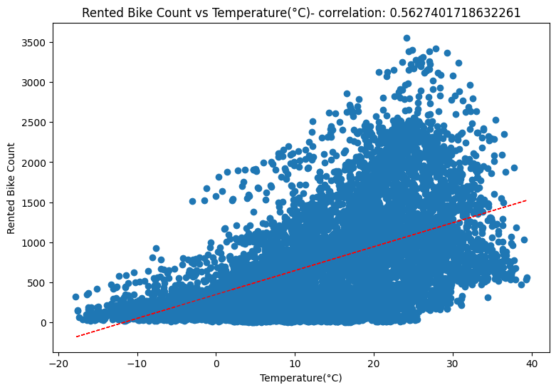
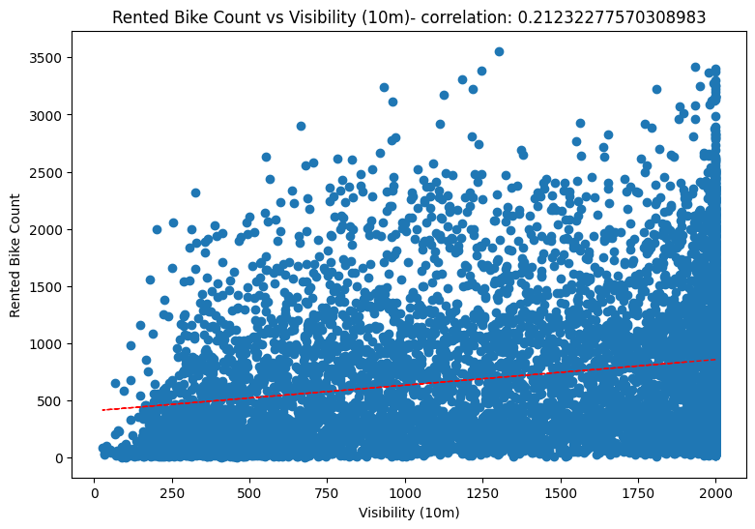
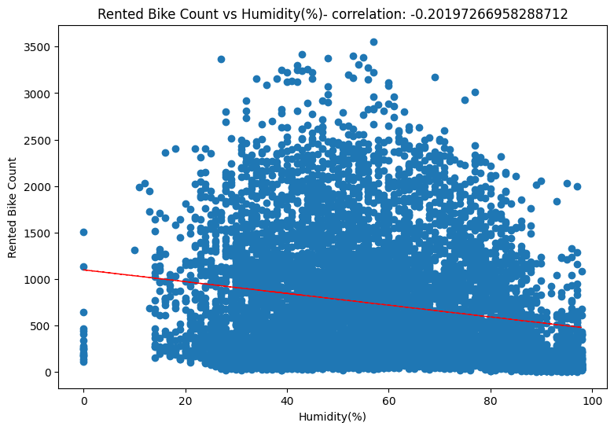
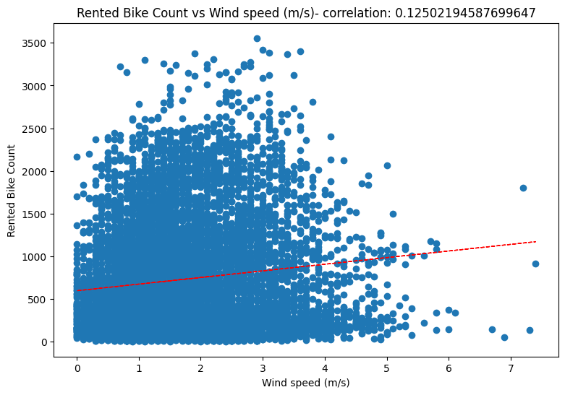
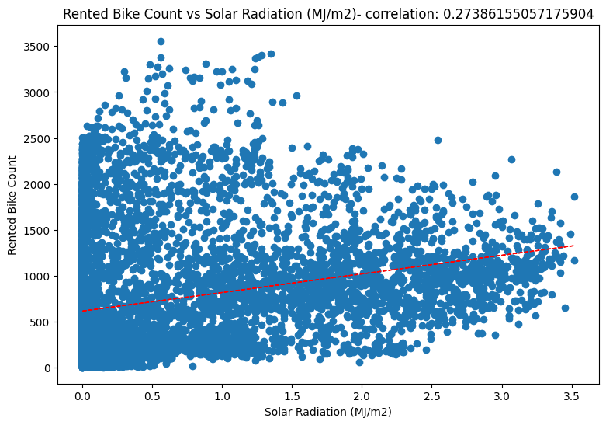
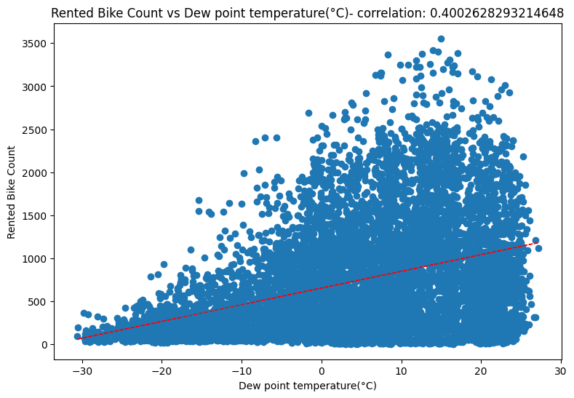
Regression Graph:
These graph which plotted to show the line of best fit.An all blue dots are the data points of the variable.The Regression best fit line passes through a datapoint which gives us a best accuracy.The purpose of this graph is to plot a correlation of I independent variable with the Rented Bike Count.so the correlation percentage value is given in the title of each individual graph.

Slide 18
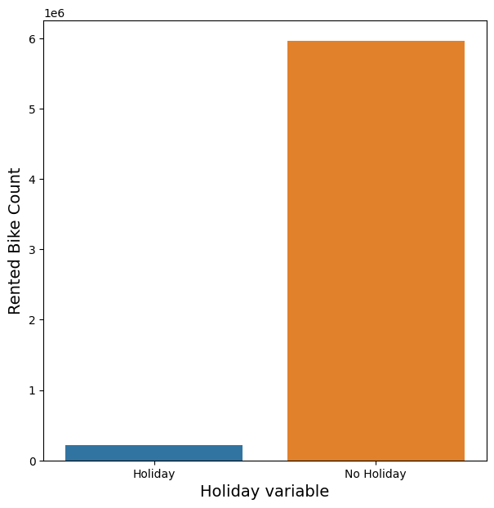
Holiday relation with Dependent variable:-
This graph is a bar graph and in this graph Rented Bike count of holiday and no holiday is displayed.so in case of No Holiday Rented bike count is very high as compared to holiday.as it is obvious that during No holiday the people need of bike to go to their Work.

Slide 19
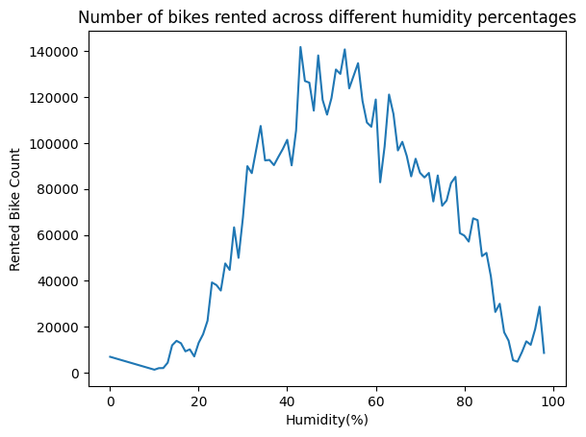
Effect of Humidity on Rented Bike Count:-
Here in this line plot on x axis the Humidity and on y axis the Rented Bike count is Described. And by observation of this graph we see that the Bike count is high in between 30 to 60 percentage.

Slide 20
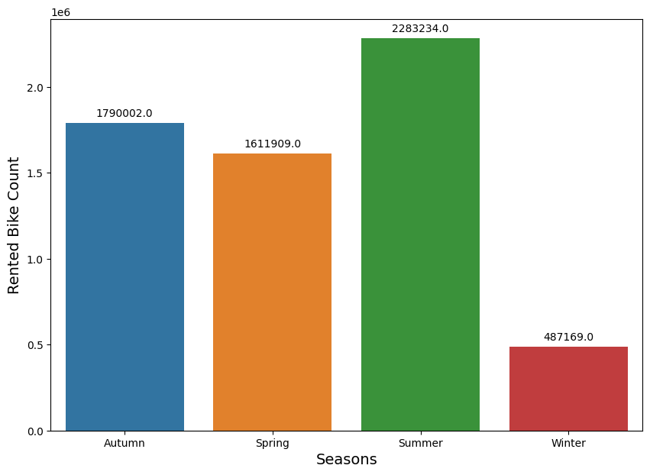
Relationship of Seasons with rented bike count:-
In the given chart on x-axis the Season is given and on y-axis Rented bike count. As we can see in case of summer Rented Bike count is higher followed by Anthem and spring but in case of Winter the bike count is very less.It might be because people mostly avoid to prefer Bike in winter due to cold.

Slide 21
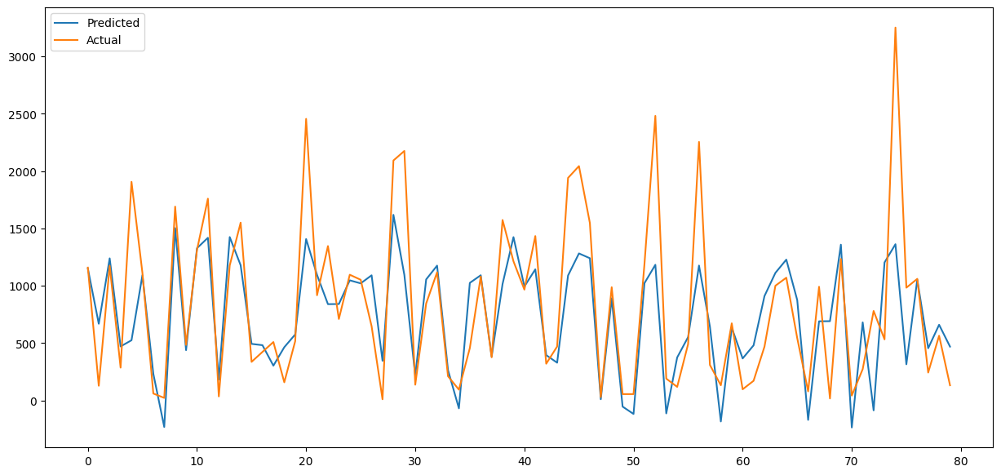
LinearRegression:-
Linear regression is an algorithm that provides a linear relationship between an independent variable and a dependent variable to predict the outcome of future events.This is our Linear regression Model Prediction and the r2-score is 0.5185 The adjusted r2-score is 0.5145 .so as this is not an ideal score we can do some more modeling on our variables.

Slide 22

Lasso Regression:-
Lasso regression algorithm is defined as a regularization algorithm that assists in the elimination of irrelevant parameters, thus helping in the concentration of selection and regularizes the models.The r2-score of our Lasso model is 0.5185 and adjusted r2-score is 0.5145 .

Slide 23

Ridge Regressor:-
Model 3 this is a Ridge Regressor and in this Regression the R2-Score=0.5185 ,Adj r2-score=0.5145 these scores are almost similar to the previous algorithm so these scores are not that much impressive.

Slide 24
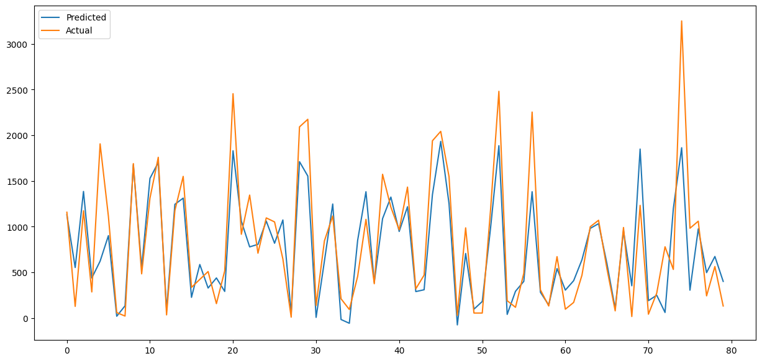
Polynomial Regression:-
Polynomial Regression describes the fitting of a nonlinear relationship between the value of x and the conditional mean of y.so Here R2-score=0.6941,adj R2-score=0.6679 so here in this model the score is increased and this model is better model as compared to previous three models.

Slide 25
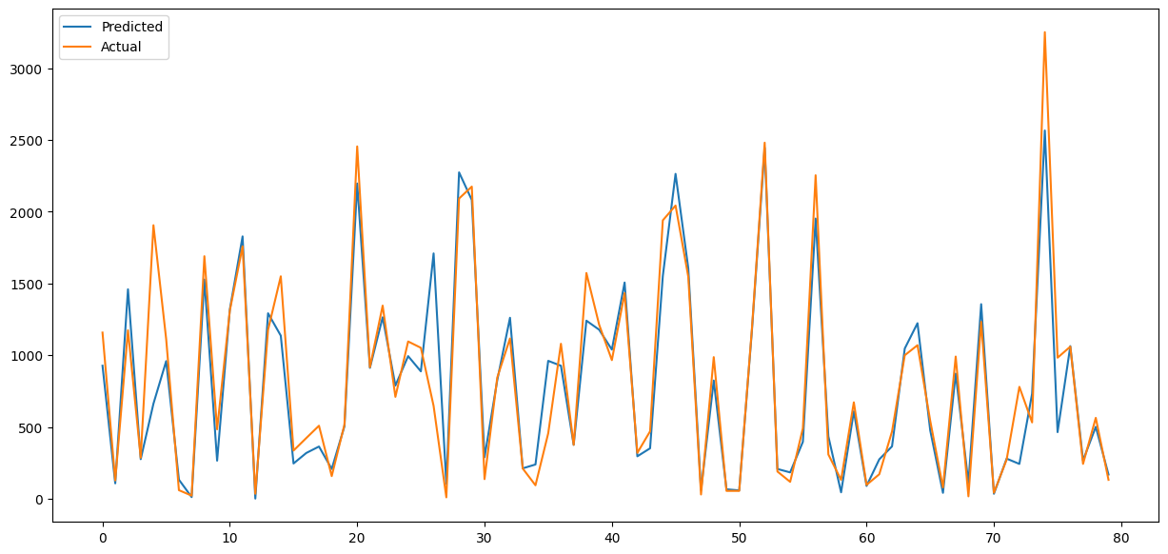
Gradient Boosting Regressor:-
Gradient boosting Regression calculates the difference between the current prediction and the known correct target value.This Regression model is the best model among all models defined in this project because its adj r2-score is 0.8863, R2-score is 0.8872.

Slide 26
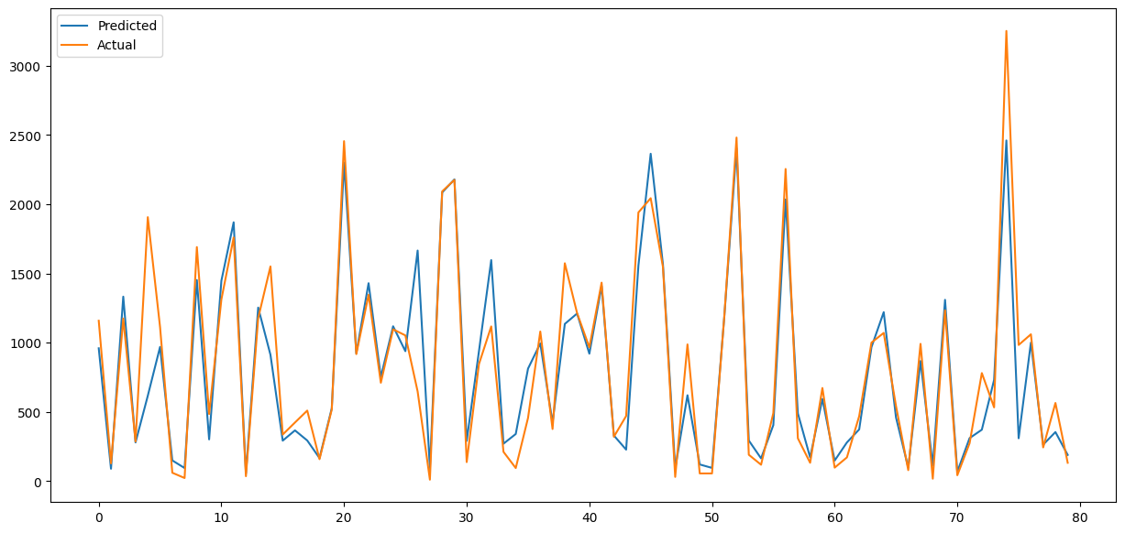
Adaboost Boost Regression:-
An AdaBoost regressor is a meta-estimator that begins by fitting a regressor on the original dataset and then fits additional copies of the regressor on the same dataset but where the weights of instances are adjusted according to the error of the current prediction.The scores areR2 : 0.8792,Adjusted R2 : 0.8782.

Slide 27
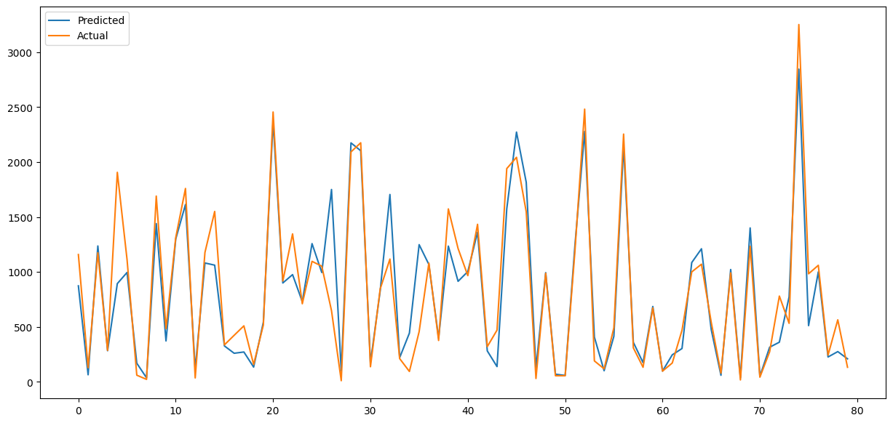
XGBoost Regression:-
The next algorithm is xgboost. XGBoost is an optimized distributed gradient boosting library designed to be highly efficient, flexible and portable. It implements machine learning algorithms under the Gradient Boosting framework.
R2 : 0.852
Adjusted R2 : 0.8511

Slide 28
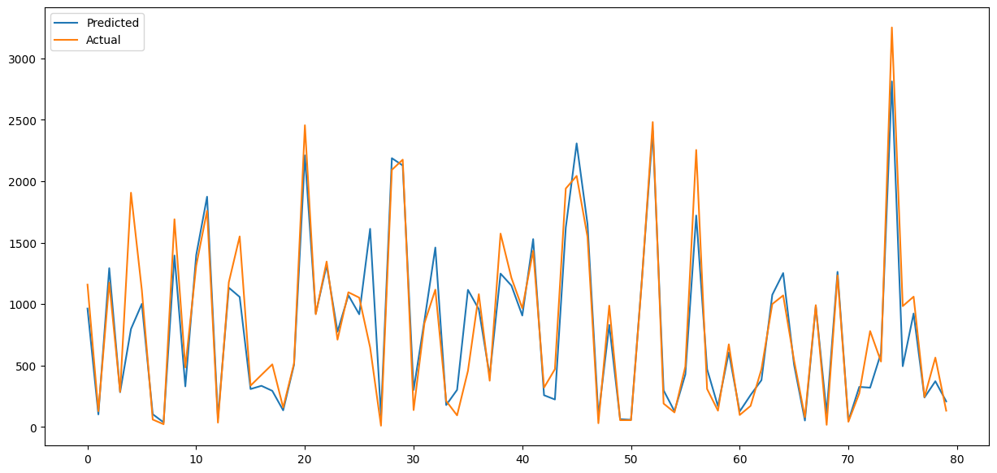
RandomForest Regression:-
A meta estimator that fits a number of classifying decision trees on various sub-samples of the dataset and uses averaging to improve the predictive accuracy and control over-fitting is called as RandomForest Regression.Here
R2 : 0.852,Adjusted R2 : 0.851.

Slide 29
Conclusion:-
As no Functioning Day has 0 Rented Bike count so we removed no Functioning day count and after that all are functioning days so there is no use of functioning days so we dropped the column
Here we done one Hot Encoding it is easy and time saving task.
To avoid Multicollinearity with Temperature we dropped Dew point Temperature
During Holiday the demand of bike is decrease as well as during weekend demand of bike is very less.
In winter as compared to other seasons the Rented Bike count is significantly low

Slide 30
conclusions based on model:-
Gradient_boosting is the most suitable model as its R2-score is 0.8863 and its adjusted-R2 is score 0.8872.
Here Linear Regression and Polynomial Regression not performed well as there is no linear relationship between dependent and independent variables.

Slide 31
Thank You…

